Slide 1
Patterns
Software Design Patterns

Slide 2
Section 11
Patterns: Spreading the Word - Linda Rising
http://www.agcs.com/supportv2/techpapers/patterns/papers/object.htm
Design Patterns: Elements of Reusable Architectures
by
Linda Rising
http://www.agcs.com/supportv2/techpapers/patterns/papers/patterns.htm
Nov 2020 MSc Slide

Slide 3
Design Patterns
Good programs often formed by imitating solutions
      older
      similar
      proven
Design Patterns formalize this process of imitation
Nov 2020 MSc Slide

Slide 4
Design Patterns
Good programs often formed by imitating solutions
      older
      similar
      proven
Design Patterns formalize this process of imitation
Nov 2020 MSc Slide

Slide 5
Definitions
“Design patterns constitute a set of rules describing how to
accomplish certain tasks in the realm of software
development.” (Pree, 1994)
“A pattern addresses a recurring design problem that arises
in specific design situations and presents a solution to it”
(Buschmann, et. al. 1996)
Nov 2020 MSc Slide

Slide 6
Design Patterns -characteristics
Smart - novice would not think of solution immediately
Generic - many applications
Well-proven
Simple
Reusable
Object Oriented
Nov 2020 MSc Slide

Slide 7
Design Patterns -implementation
Two common implementation themes:
top of any class Hierarchy is defined ‘abstact’
favour object composition over inheritance
Nov 2020 MSc Slide

Slide 8
Patterns divided into 3 categories
Creational
Structural
Behavioral
Nov 2020 MSc Slide

Slide 9
Cat 1: Creational Pattern
create objects for you,
rather than having you instantiate objects directly.
gives your program more flexibility in deciding which
objects need to be created for a given case.
Nov 2020 MSc Slide

Slide 10
Structural Pattern
compose groups of objects into larger structures
such as complex user interfaces or accounting data.
Nov 2020 MSc Slide

Slide 11
Behavioral Pattern
define the communication between objects in your system
how the flow is controlled in a complex program.
Nov 2020 MSc Slide

Slide 12
Example
Will look at specific patterns
Some from each category
Nov 2020 MSc Slide

Slide 13
Combining Decorator & Factory Patterns
Decorator Pattern

Slide 14
class Account:
def __init__(self, name, balance):
self.__name = name
self.__balance = balance
self._message = ""
def getBalance(self):
return self.__balance
def deposit(self, amt):
self.__balance += amt
def withdraw(self, amt):
self.__balance -= amt
def getName(self):
return self.__name
Base Account
def writeMessage(self, msg):
self._message=msg
def readMessage(self):
return self._message

Slide 15
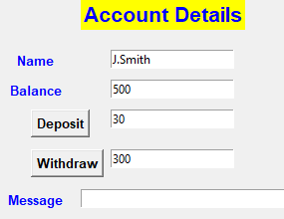
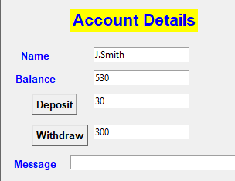


Slide 16


Slide 17
During Testing Phase
- we introduce trace printouts
def deposit(self, amt):
self.writeMessage("deposit() called")
self.__balance += amt

Slide 18
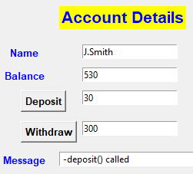
class Account:
def __init__(self, name, balance):
self.__name = name
self.__balance = balance
self._message = ""
def getBalance(self):
return self.__balance
def deposit(self, amt):
self.writeMessage("deposit() called")
self.__balance += amt
def withdraw(self, amt):
self.writeMessage(“withdraw() called")
self.__balance -= amt
def getName(self):
return self.__name
Trace Statements

Slide 19
Unsatisfactory
Must be removed after testing
What if you need to retest later
Different test phases my require different types of traces
Alternative Solution using Decorator Pattern

Slide 20
Account
UML Class Diagram
Decorator
Account
TestAcc
NoOverdraftAcc
GuiTest

Slide 21
Solution

Slide 22
class Account:
def __init__(self, name, balance):
self.__name = name
self.__balance = balance
self._message = ""
def getBalance(self):
return self.__balance
def deposit(self, amt):
self.__balance += amt
def withdraw(self, amt):
self.__balance -= amt
def getName(self):
return self.__name
Base Account
No Change
def writeMessage(self, msg):
self._message=msg
def readMessage(self):
return self._message

Slide 23
class Decorator(Account):
def __init__(self, acc):
super().__init__("",0) # any valid data
self._account = acc

Slide 24
class TestAcc(Decorator):
def __init__(self, acc):
super().__init__(acc)
def getBalance(self):
return self._account.getBalance()
def deposit(self, amt):
self.writeMessage(" -deposit() called")
self._account.deposit(amt)
def withdraw(self, amt):
self.writeMessage(" -withdraw() called")
self._account.withdraw(amt)
:
Decorate deposit,
withdraw

Slide 25
Must include All
Methods in decorator
:
def getName(self):
return self._account.getName()
def writeMessage(self, msg):
self._account.writeMessage(msg)
def readMessage(self):
return self._account.readMessage()

Slide 26
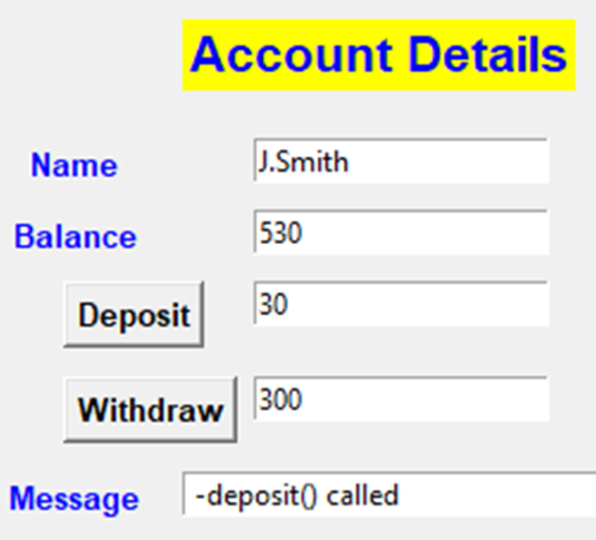

In GUI change Object Definition
#a1=Account("J.Smith",500)
a1=TestAcc(Account("J.Smith",500))
label1 = Label(window, text="Account Details", fg="blue",
bg="yellow", font=("arial", 16, "bold"))
label1.place(x=90, y=30)

Slide 27

After Testing we can change Back
a1=Account("J.Smith",500)
#a1=TestAcc(Account("J.Smith",500))
label1 = Label(window, text="Account Details", fg="blue",
bg="yellow", font=("arial", 16, "bold"))
label1.place(x=90, y=30)

Slide 28
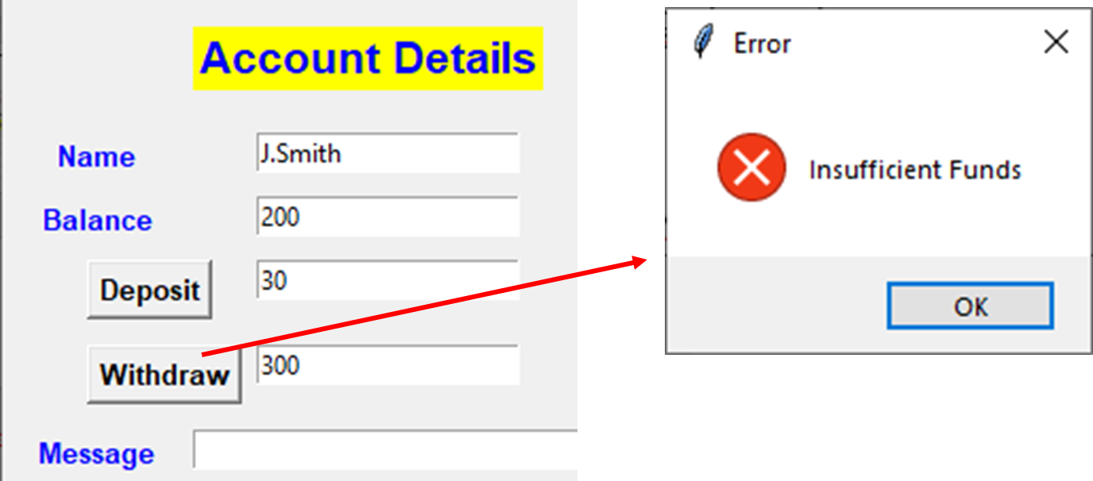
We can create other decorators
NoOverdraft
Won’t allow Withdraw if Insufficient Funds
#a1=TestAcc(Account("J.Smith",500))
a1=NoOverdraft(Account("J.Smith",500))

Slide 29
from tkinter import messagebox
class NoOverdraft(Decorator):
def __init__(self, acc):
super().__init__(acc)
def getBalance(self):
return self._account.getBalance()
def deposit(self, amt):
self._account.deposit(amt)
def withdraw(self, amt):
if (amt>self.getBalance()):
messagebox.showerror("Error", "Insufficient Funds")
else:
self._account.withdraw(amt)
:

Slide 30

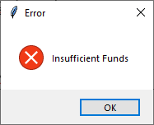
:
def getName(self):
return self._account.getName()
def writeMessage(self, msg):
self._account.writeMessage(msg)
dereadMessage(f self):
return self._account.readMessage()
NoOverdraft continued

Slide 31

NoOverdraft
+ TestAcc
We can combine decorators
#a1=TestAcc(Account("J.Smith",500))
a1=TestAcc(NoOverdraft(Account("J.Smith",500)))

Slide 32
4 Options
#1. a1=Account("J.Smith",500)
#2. a1=TestAcc(Account("J.Smith",500))
#3. a1=NoOverdraft(Account("J.Smith",500))
#4. a1=NoOverdraft(TestAcc(Account("J.Smith",500)))
# or
# a1=TestAcc(NoOverdraft(Account("J.Smith",500)))
This Pattern is also referred to as a Wrapper

Slide 33

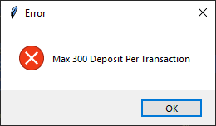
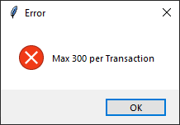
Ex341: Now we want to create a new Type ‘Limited’ Account
a1=Limited(NoOverdraft(TestAcc(Account("J.Smith",500))))
#a1=Limited(Account("J.Smith",500))
Limit Deposit/Withdraw to Max 300 per transaction

Slide 34
Exercise342:
Given the class
class Counter{
private int value;
public Counter(int v){value=v;}
public Counter(Counter cc){ value=cc.value;}
public int read_value(){return value;}
public void increment(){value++;}
public void decrement(){
value--;}
}
Now we want to decorate the Counter (similar to Account Ex)

Slide 35
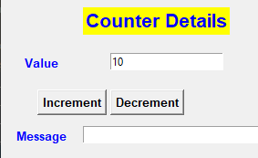

class Counter:
def __init__(self, val):
self.__value = val
self._message=''
def getValue(self):
return self.__value
def increment(self):
self.__value += 1
def decrement(self):
self.__value -= 1
def writeMessage(self, msg):
self._message=msg
def readMessage(self):
return self._message
Exercise342:
Given the class

Slide 36
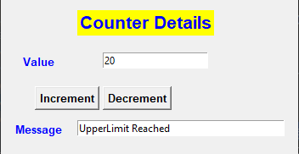
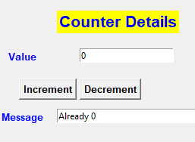
We want to Decorate Counter as follows
(i) class UpperLimit
increment if value <20
Hint:
if (self._counter.getValue()==20):
self.writeMessage("Up…")
(ii)
class LowerLimit
decrement if value >=0

Slide 37
Ex342 Test 4 Cases
#a1=Counter(10)
#a1=UpperLimit(Counter(10))
#a1=LowerLimit(Counter(10))
a1=LowerLimit(UpperLimit(Counter(10)))

Slide 38
Exercise343:
Given the class
class Display:
def __init__(self, nm):
self._name= nm
def printName(self):
print("Name= ", self._name)
def updateName(self, nm):
self._name = nm
Now we want to decorate the Display (i.e. def printName(self): )

Slide 39
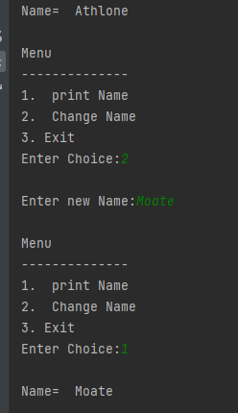
Exercise343:
Given the class
Regular Display
def main():
d1=Display("Athlone")

Slide 40
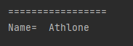
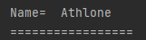
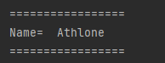
Ex343 We want to Decorate Display as follows
(i) class OverLine
d1=OverLine(Display("Athlone"))
(ii)
class LowerLimit
d1=UnderLine(Display("Athlone"))
(ii) Wrapped
d1=UnderLine(OverLine(Display("Athlone")))

